Slide 1









Team 22
Alzheimer's Disease Detection
An end-to-end machine learning pipeline achieving 95.12% accuracy using XGBoost, integrated with cognitive assessment games for early diagnosis.
Data Collection
Analysis
Model Development
Deployment
Kokane Manoj Bhausaheb (manojkokane@iisc.ac.in)
Parth Bhatia (parthbhatia@iisc.ac.in)
Swapnil Trivedi (swapnilt@iisc.ac.in)
Machine Learning & Healthcare Analytics

Slide 2






Project Overview & Goals
Comprehensive Workflow
Primary Goal
Data Collection
Develop an accurate machine learning system for the early detection of Alzheimer's Disease (AD) using clinical, demographic, and lifestyle data.
Using existing clinical, demographic, and lifestyle data from 2,150 patients
Exploratory Data Analysis
Identifying key patterns and predictive features
Final Result
Data Preprocessing
Cleaning, standardization, and feature engineering
Deployed system achieving 95.12% Accuracy using XGBoost
Model Development
Interactive web application with integrated cognitive assessment games
Comparing multiple algorithms and selecting XGBoost
Deployment
Creating interactive web application with cognitive assessments
2 / 10

Slide 3


















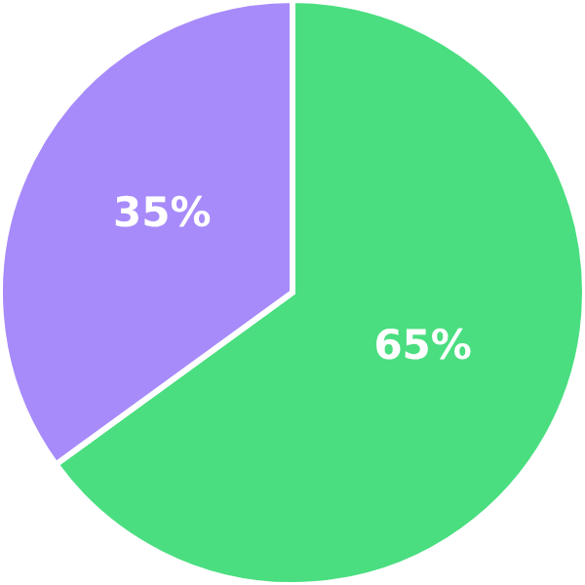


Data Collection & Understanding
Dataset Overview
Feature Set
Size: 2,150 unique patient records
Comprehensive clinical features including:
Features: 32 features
Demographics
Vital Signs
Quality: Zero missing values, no duplicates
Age, gender, education level
Blood pressure, heart rate
Class Distribution: 65% Healthy (1,397) vs. 35% Alzheimer's (753)
Cognitive Assessments
Medical History
MMSE, Functional Assessment
Hypertension, diabetes
Target Class Distribution
Lifestyle Factors
ADL Scores
Healthy: 65% (1,397 patients)
Physical activity, sleep quality
Activities of daily living
Alzheimer's: 35% (753 patients)
Class ratio: 1.86:1 (Healthy:Alzheimer's)
3 / 10

Slide 4

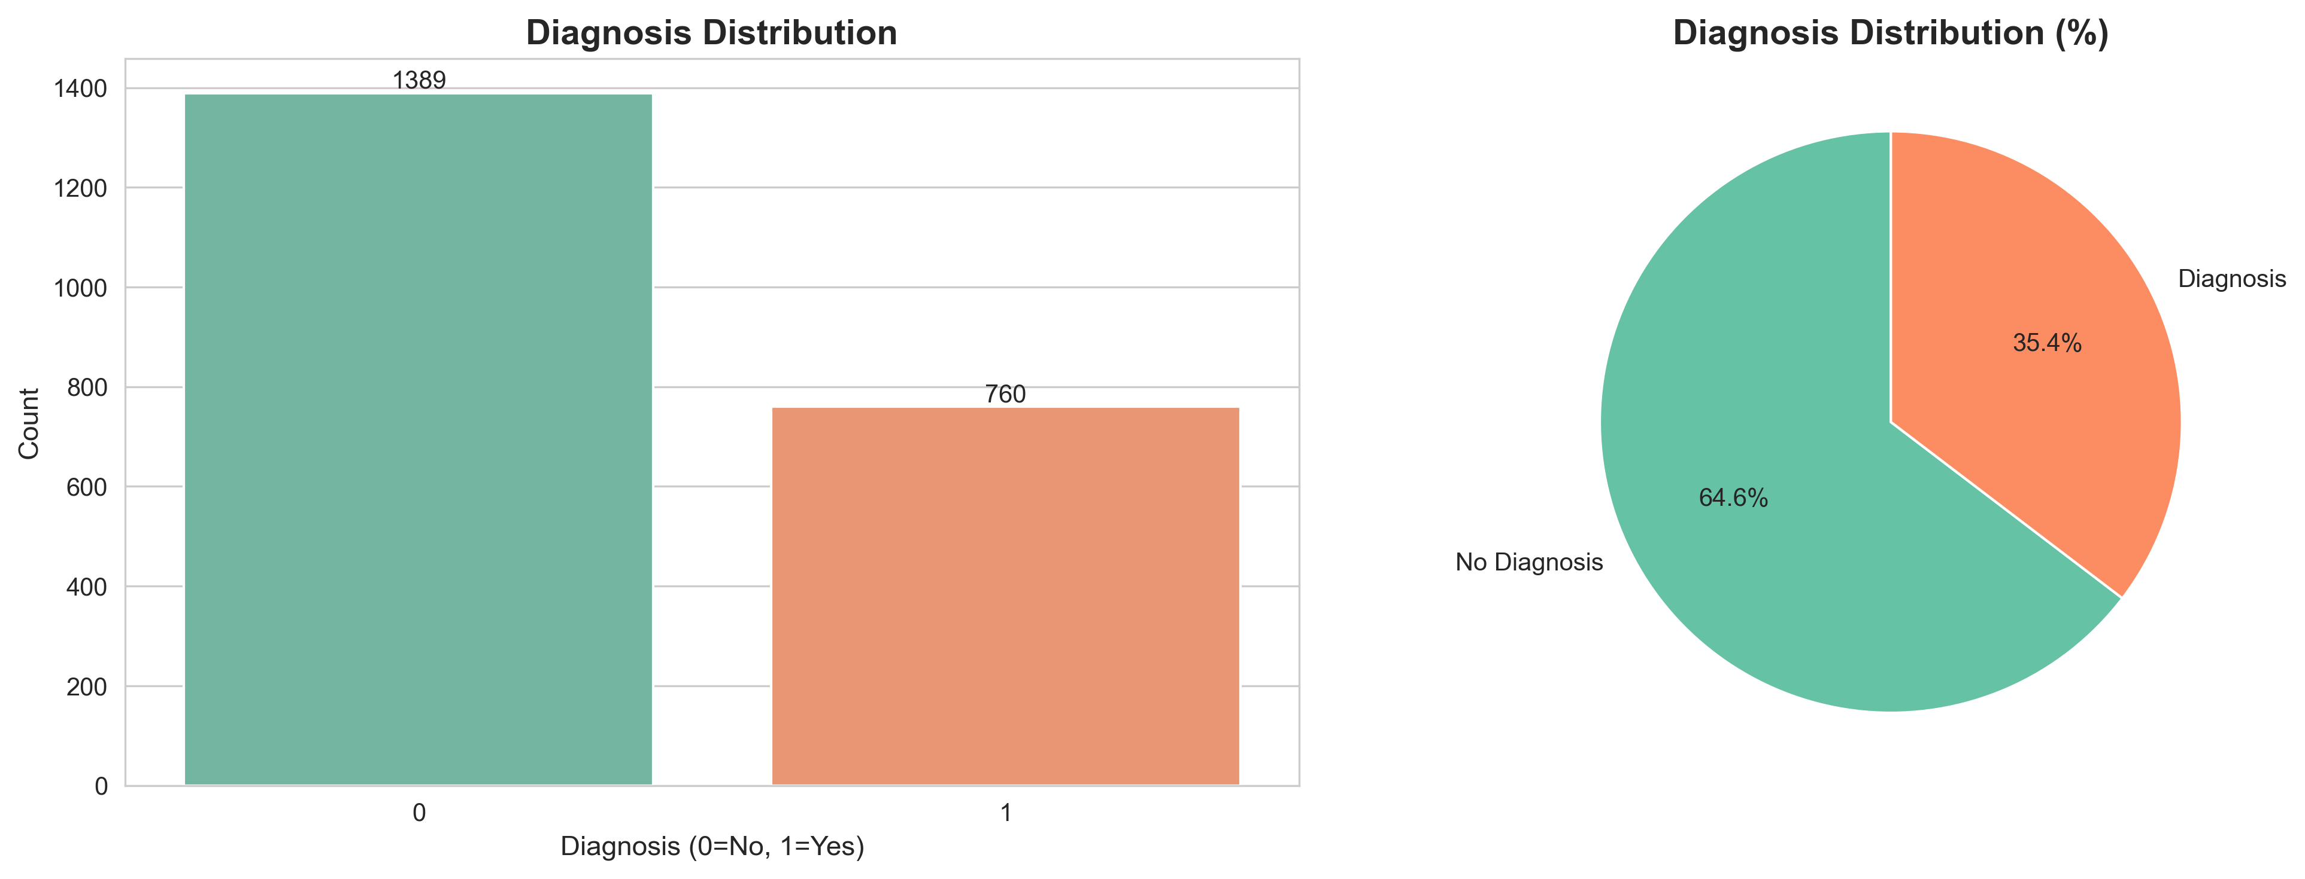
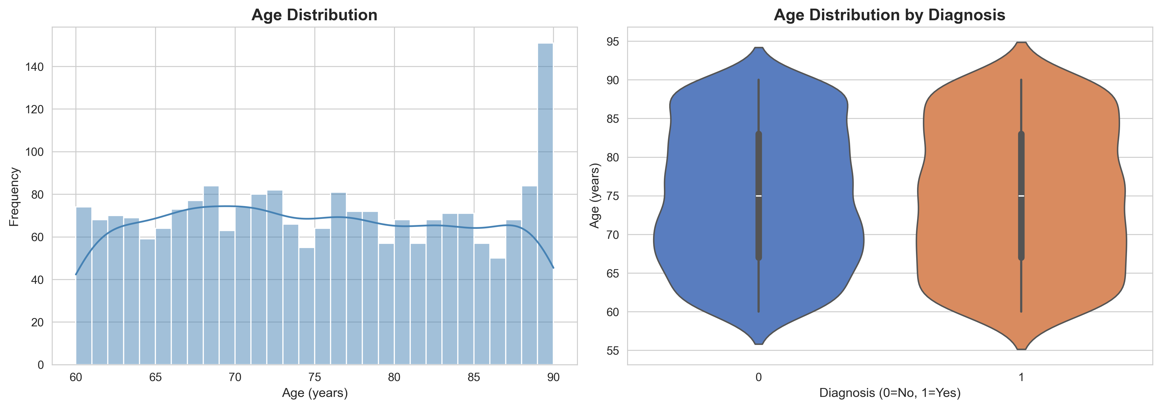
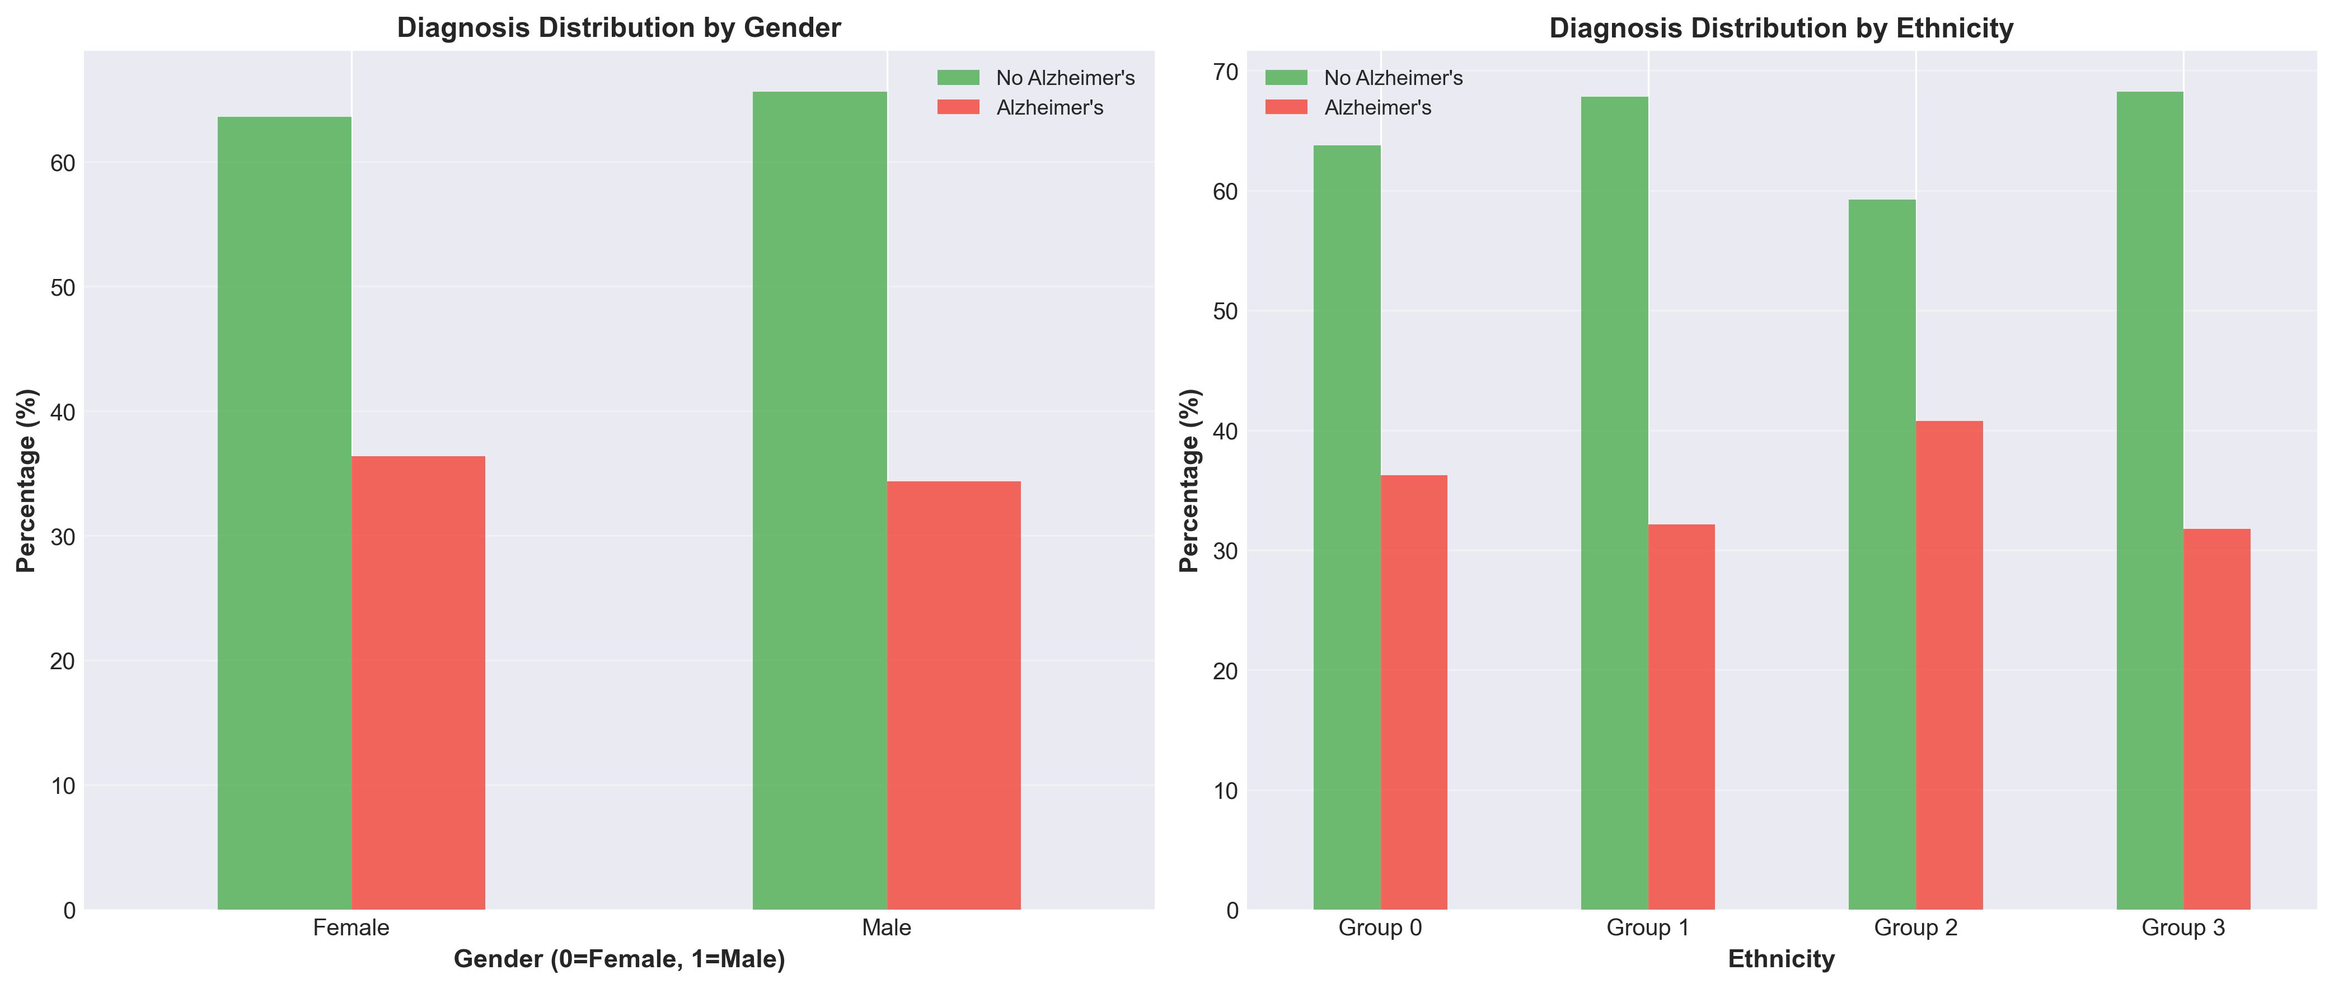
Exploratory Data Analysis - Key Patterns
4 / 10

Slide 5
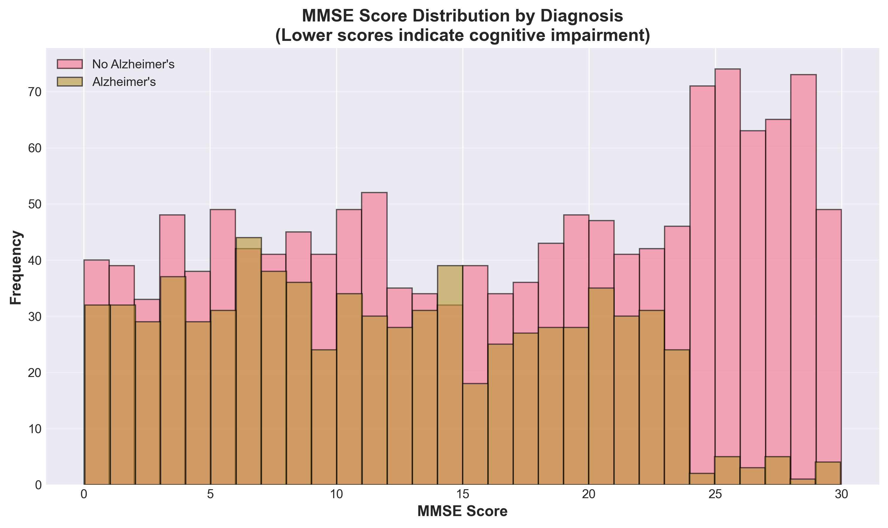
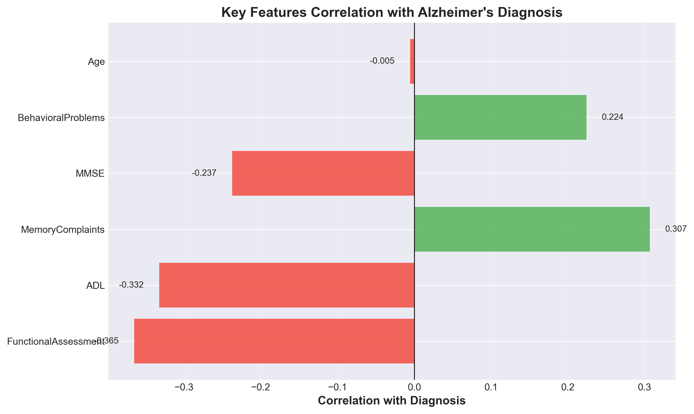
Exploratory Data Analysis - Key Patterns
4 / 10

Slide 6




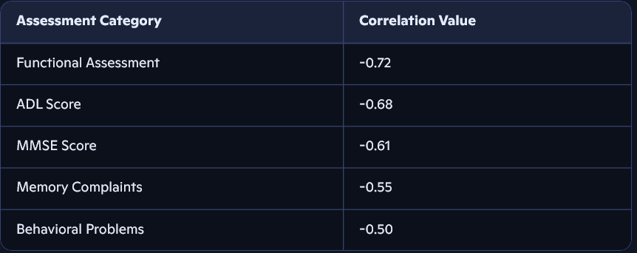
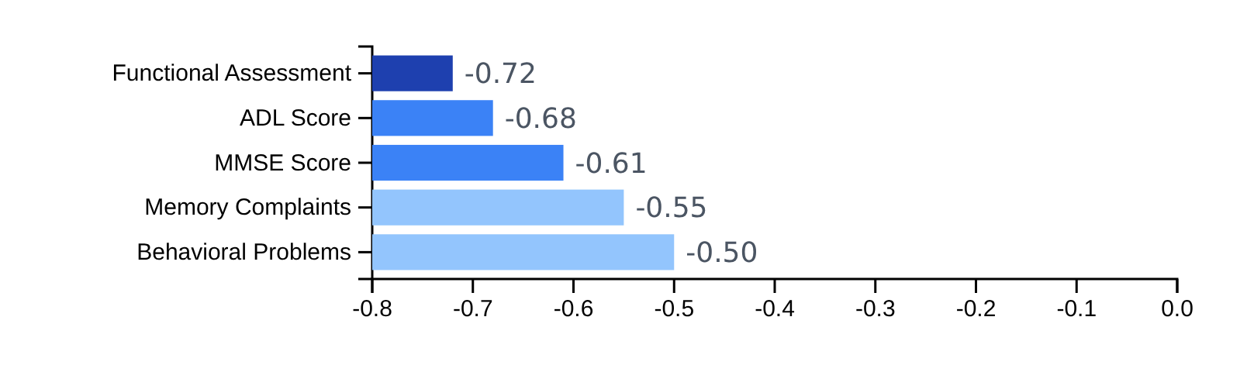









Exploratory Data Analysis - Key Patterns
Cognitive Assessments
Age as Predictor
Mean Age (AD)
vs
Mean Age (Healthy)
Strongest Correlations
81.2 years
72.1 years
p<0.001
Symptom Clustering
Memory Complaints
89%
Behavioral Problems
85%
Forgetfulness
82%
Key Insights
Functional Assessment: Strongest single predictor (r=-0.72)
ADL Score: Strong negative correlation (r=-0.68)
MMSE Score: Mean 8.1 (AD) vs. 22.4 (Healthy) (r=-0.61)
Top 5 features account for 66% of predictive power
4 / 10

Slide 7











Data Preprocessing & Feature Engineering
Train-Test Split
Standardization
80/20 stratified split
StandardScaler applied to all 32 features:
Maintains 65:35 class distribution
z = (x - μ) / σ
Critical for Neural Network training
Addressing Class Imbalance
Stratified sampling preferred over oversampling
753 positive samples deemed sufficient
Feature Engineering
Features Retained
Engineering Required
32
None
Raw features already clinically meaningful and well-distributed
5 / 10

Slide 8
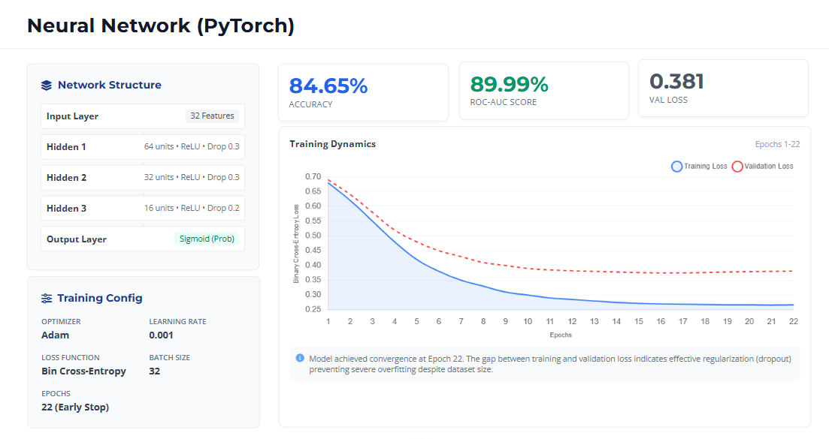
Model Development & Comparison
6 / 10

Slide 9
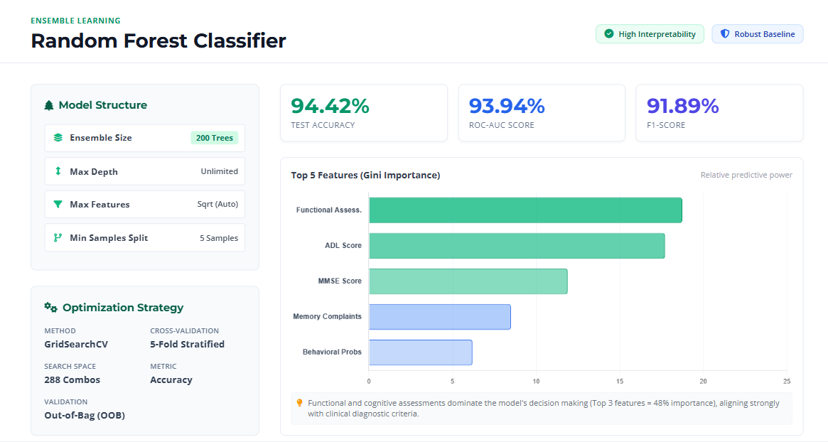
Model Development & Comparison
6 / 10

Slide 10
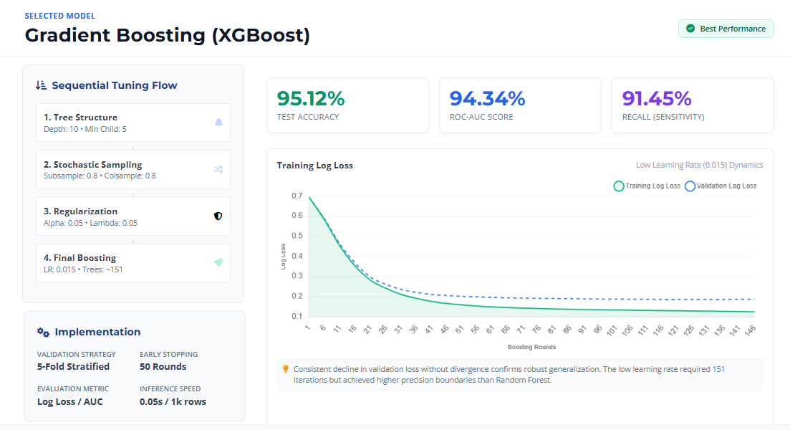
Model Development & Comparison
6 / 10

Slide 11
Model Development & Comparison
6 / 10

Slide 12
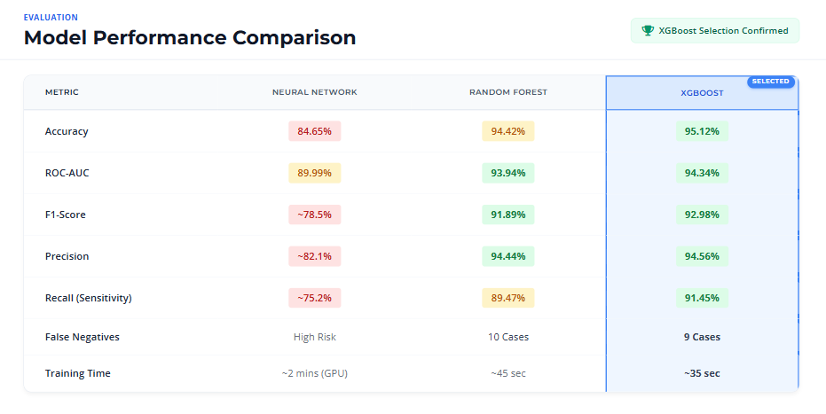
Model Development & Comparison
6 / 10

Slide 13



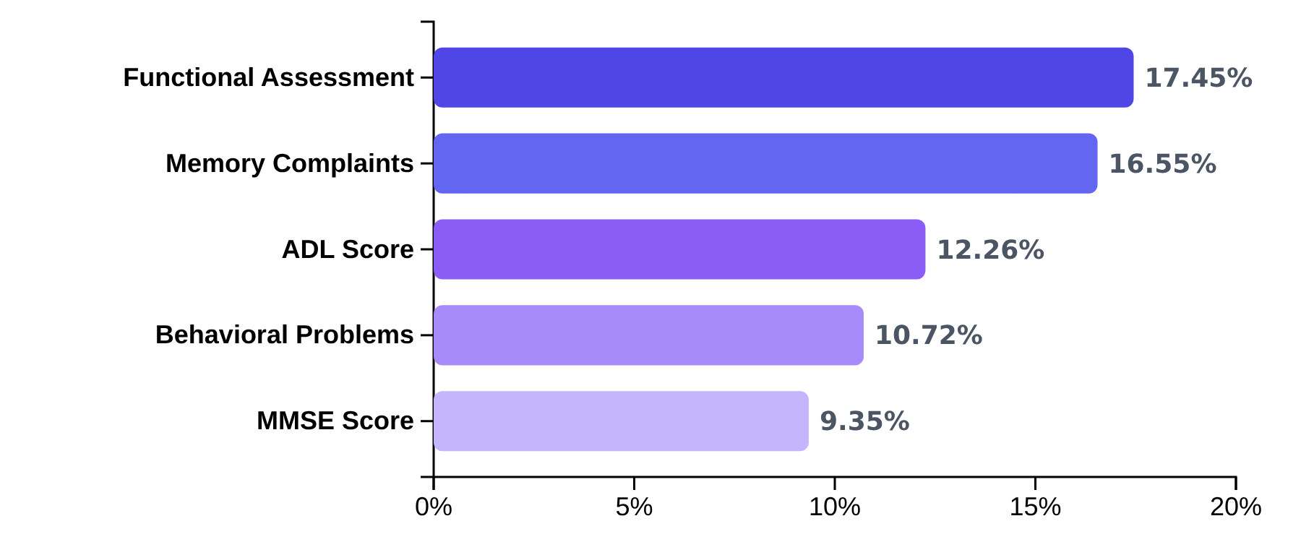





Feature Importance & Clinical Insights
Top 5 Critical Features
Clinical Insights
These features account for 66.3% of the predictive power
Cognitive Markers
Functional Assessment (17.45%) and Memory Complaints (16.55%) are the strongest predictors, consistent with established medical knowledge
Lifestyle Factors
PhysicalActivity (1.64%), SleepQuality (1.40%), and DietQuality (1.23%) provide actionable prevention recommendations
Key Insight: Functional Assessment and Memory Complaints are the strongest indicators, aligning with established medical knowledge
Medical History
Hypertension (2.48%) leads among medical history factors, supporting the vascular dementia hypothesis
7 / 10

Slide 14




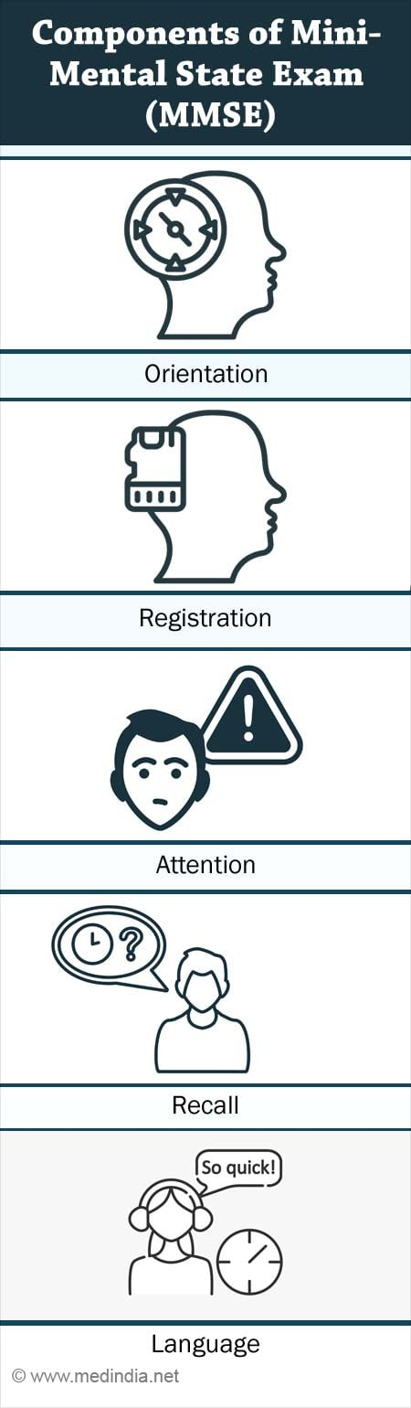


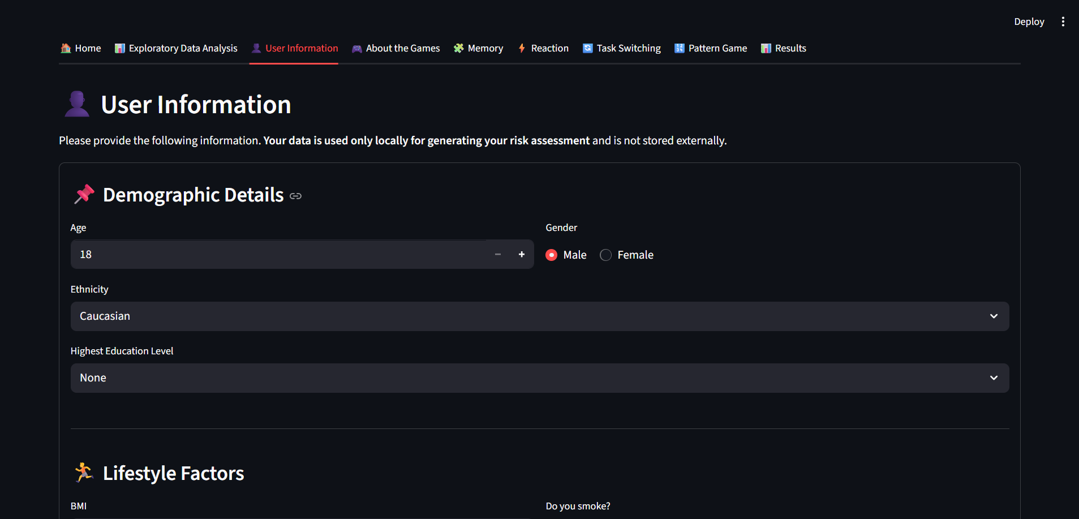

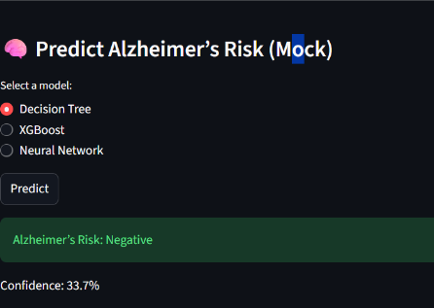







Deployment & Application Development
Production-Ready Inference Pipeline
Streamlit Application Development
6-Stage Architecture
Interactive UI
1
Validation - Input checks and data type verification
Multi-section form with intuitive widgets
2
Preprocessing - Standardization using training statistics
3
Model Prediction - XGBoost classification
4
Confidence Scoring - High/Medium/Low confidence levels
5
Risk Stratification - Clinical risk level mapping
6
Output Generation - JSON response with prediction results
Cognitive Assessment Games
Memory Game
Pattern Recognition
Reaction Time
Task Switching
Cognitive Games
Real-time Prediction
8 / 10
Integrated games to generate user profile
Instant results with risk gauge and interpretability

Slide 15
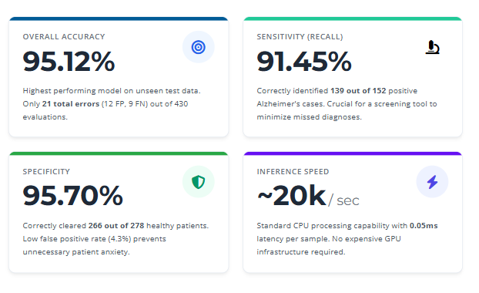






Results & Performance Summary
Clinical Value
Early Detection
Identifies patients in early stages
Minimized Follow-up
Reduces unnecessary testing
9 / 10

Slide 16













Key Findings & Future Enhancements
Key Findings
Future Enhancements
Cognitive Supremacy
Longitudinal Modeling
Direct cognitive assessments account for 66% of predictive power
Integrate time-series data to predict progression rates
Modifiable Factors
Multimodal Integration
Lifestyle features enable identification of high-risk individuals
Combine clinical features with imaging and biomarker data
Early Detection
Real-time Monitoring
High sensitivity enables detection of patients with moderate MMSE scores
Develop mobile app for periodic cognitive assessments
Clinical Alignment
Feature importance aligns with established medical knowledge
SHAP Explanations
10 / 10
Implement SHAP values for prediction transparency
Project Success: 95.12% accuracy

Slide 17
Thank You …
9 / 10

